Slide 1

VR Lab
Team Members: Omar Irfan Khan, Mohammad Eyad Masoud
Senior design Advisor: Dr. Abdul Halim Jallad

Slide 2
Outline
Background
Problem Definition
Design Specifications
Project Management
Costs
Plans for Senior II

Slide 3
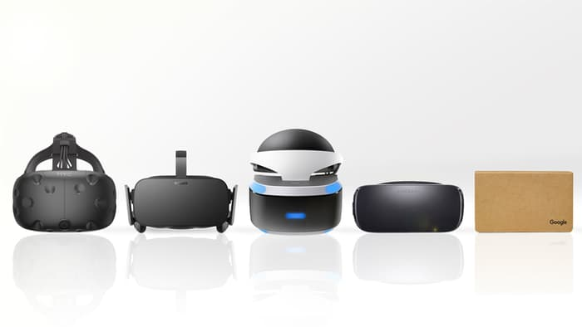
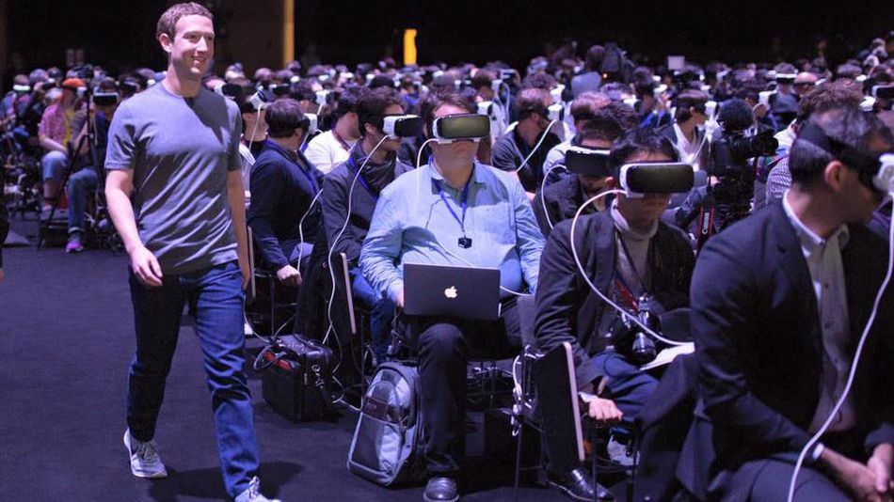
Background
Virtual Reality (VR) is the use of computer technology to create a simulated environment
VR tries to simulate as many of our senses as possible such as vision, hearing, touch and even smell.
Notes:
VR is a disruptive technology.

Slide 4
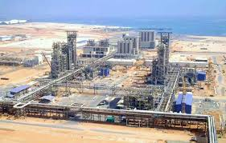



Problem Definition
There are only three universities besides AURAK that teach petroleum engineering in all of UAE.
One of the requirements to teach petroleum engineering at an undergraduate level is to have a suitable laboratory fitted with the right apparatus

Slide 5
Design
Design is divided into 3 components:
Game Engine
Object/Asset Creation
Audio Effects

Slide 6




Game Engine
Unity has a great asset store and provides real time global illumination and has a built in audio mixer.
Unity uses C#, JavaScript and boo where as Unreal uses unreal script and is mainly used for blueprint making.
Alternatives: we can use CryEngine, Amazon Lumberyard or Unreal.
Notes:
Unity uses C#, JS and boo while unreal uses C++ and unreal script which is derived from java and mainly used for blueprint making

Slide 7



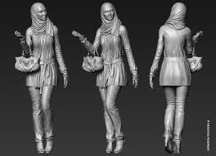
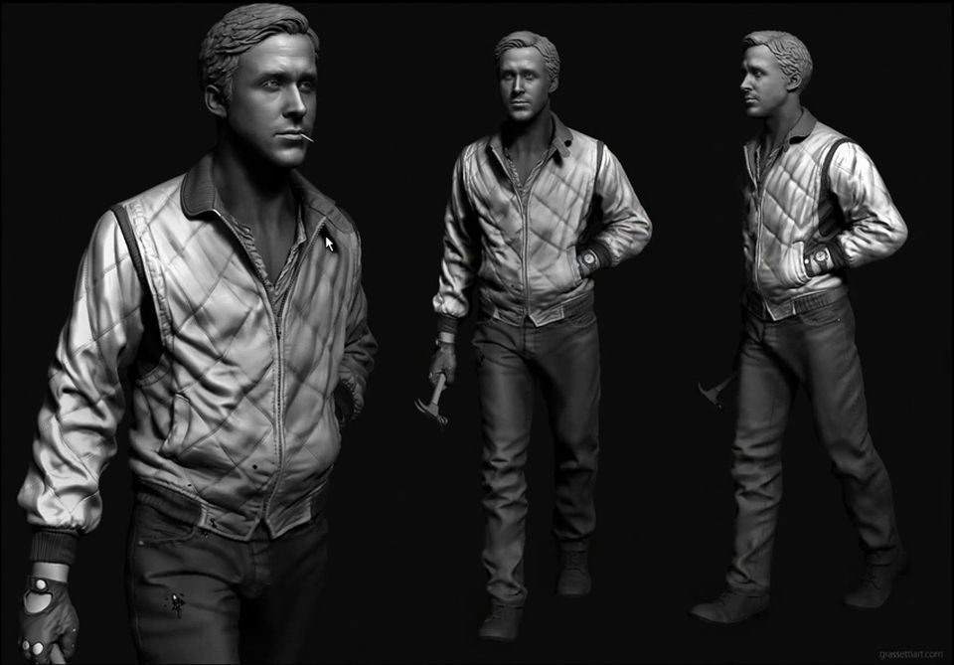
Object/Asset Creation
Use blender to create the apparatus and export it to the game engine.
Blender boasts photorealistic rendering, fast rigging, UV wrapping, fluid and smoke simulation etc.
Alternatives: Maya, Zbrush and Sculptris.

Slide 8


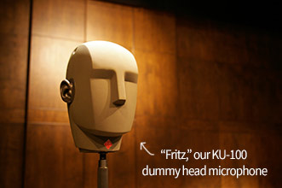
Audio Effects
Audacity and AudioKinetics Wwise are both excellent softwares for producing audio effects. However, Audacity is free and Wwise has a catch.
Alternatives: OcenAudio, Adobe Audition and Wavosaur.
Notes:
Wwise recently announced free binaural audio support for vr projects. Binaural (means having or relating to two ears) recordings works by placeing uses two microphones arranged with the intent to create a 3-D stereo sound sensation for the listener of actually being in the room with the performers or instruments.

Slide 9
Project Timeline
Researching on relevant project and literature. Ordering of the VR Equipment and computer
10/23/2016
Learning about Unity and Steam VR and C#
11/7/2016
Acquiring information about Unity
Report Review with the advisor Preliminary Plan for Senior || Designing project Presentation
9/15/2016
Topic Choice and discussion
Learning about Different VR headsets
8/31/2016
10/2/2016
11/23/2016
Aug
Sep
Oct
Nov
2016

Slide 10
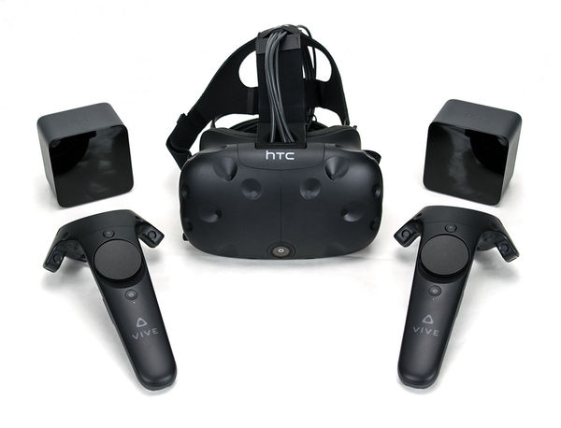
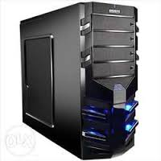
Costs and specification
Component | Cost
HTC Vive : Display : OLED Resolution : 2160 x 1200 Platform : Steam VR Controller : vive controller Tracking area : 15 x 15 feets | 3800 AED
High Specification Computer: CPU: Intel Core i5-4590 equivalent or greater Graphic card: NVIDIA GeForce GTX 970 /AMD Radeon RX 480 equivalent or greater Ram: 4GB+ of RAM | 7300 AED

Slide 11
Future plans for Senior II
Transferring these sound files and objects to Unity
Learn about Blender and how to use it
3/19/2017
1/29/2017
Implement the lighting, sprites and appropriates physics
Use Blender to make the laboratory
2/12/2017
4/9/2017
Use Audacity/Wwise to make the audio files
Testing the prototype
4/30/2017
3/5/2017
2017
Jan
Feb
Mar
Apr
2017

Slide 12
Thank you For Listening!

